Slide 1




Combining Machine Learning With Finite Element Simulations For Fast Computation In Power Module Failure Analysis Due to Wire Bond Degradation
Mehdi Ghrabli, Mounira Bouarroudj, Ludovic Chamoin, Emanuel Aldea
CNRS, SATIE & LMPS Laboratories

Slide 2
OUTLINE
Introduction
Simulations and data generation
Regression results and analysis
Machine learning beyond regression
Conclusion

Slide 3
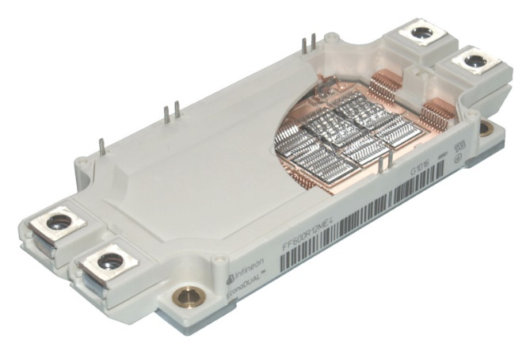
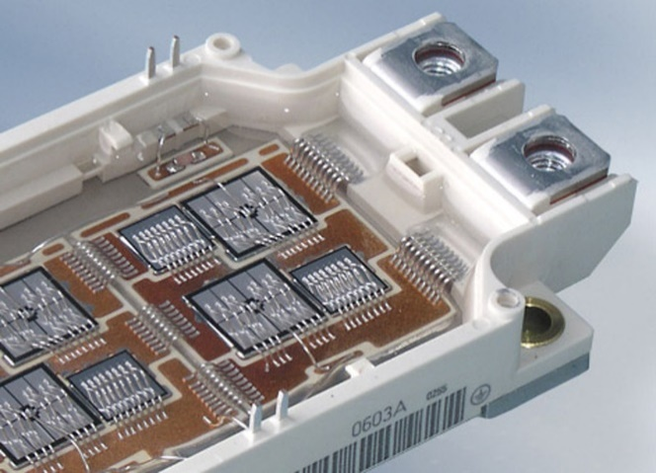
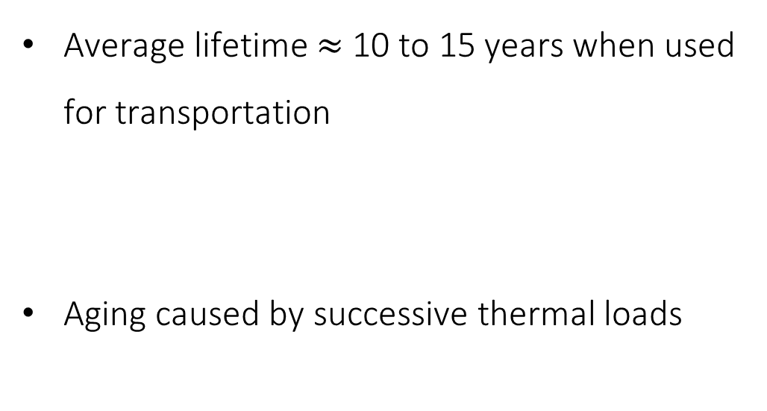
INTRODUCTION
Context
Average lifetime $≈$ 10 to 15 years when used for transportation
Aging caused by successive thermal loads
Power electronic module : Packaging (up) and interior view (down)

Slide 4
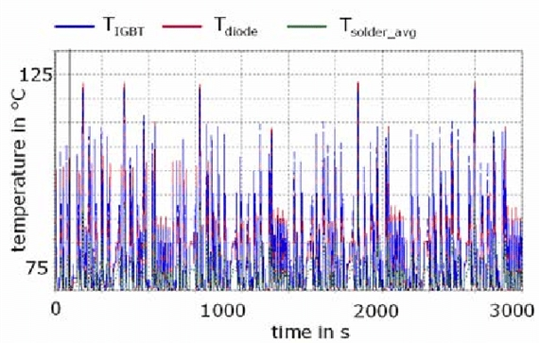
INTRODUCTION
Context
Average lifetime $≈$ 10 to 15 years when used for transportation
Aging caused by successive thermal loads
=> Unfeasible experimentally
=> Difficult to model due to variance
Loading profile of a power electronic module in an electric vehicle

Slide 5
OUTLINE
Introduction
Simulations and data generation
Regression results and analysis
Machine learning beyond regression
Conclusion

Slide 6
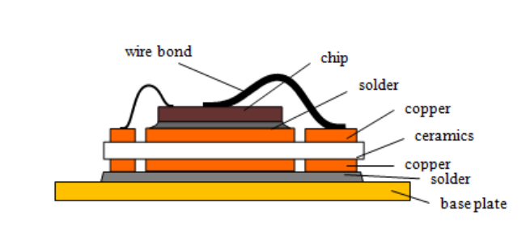
SIMULATIONS AND DATA GENERATION
Failure mechanism
Component | Material
Wire | Aluminium
Chip | Silicon
Solder | Silver
Copper layer | Copper
Ceramic layer | Ceramic
Architecture of a power module
Material composition of an IGBT power module

Slide 7
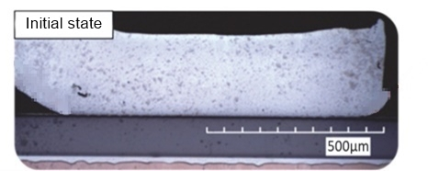
SIMULATIONS AND DATA GENERATION
Failure mechanism
Creation of thermal stress in the wire-chip interface
Architecture of a power module

Slide 8
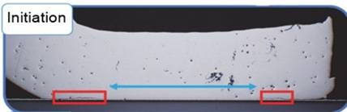
SIMULATIONS AND DATA GENERATION
Failure mechanism
Initiation of a crack due to subsequent loading
Architecture of a power module

Slide 9
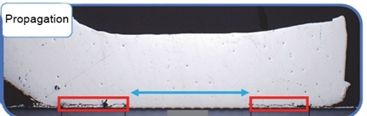
SIMULATIONS AND DATA GENERATION
Failure mechanism
Crack propagation
Architecture of a power module

Slide 10
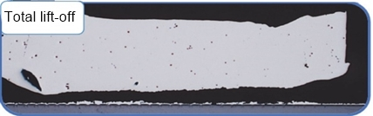
SIMULATIONS AND DATA GENERATION
Failure mechanism
Wire lift-off
Architecture of a power module
Module’s state : Health indicator (Collector-emitter voltage) ⬄ Degradation (remaining contact area due to the crack)

Slide 11
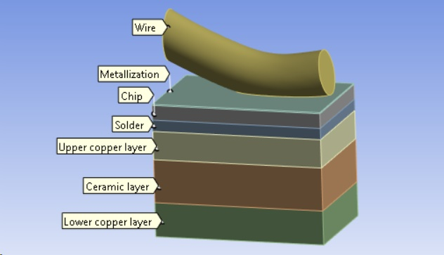
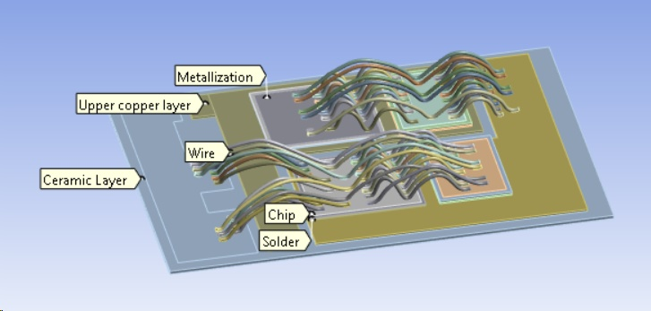
SIMULATIONS AND DATA GENERATION
Geometric modelling
Reduced geometric model of the power module
Geometric model of the power module

Slide 12
SIMULATIONS AND DATA GENERATION
Thermal loading
Current injection
Reduced geometric model of the power module

Slide 13
SIMULATIONS AND DATA GENERATION
Thermal loading
Current injection
Self heating
Reduced geometric model of the power module

Slide 14
SIMULATIONS AND DATA GENERATION
Thermal loading
Current injection
Self heating
Thermal stress in contact area
Reduced geometric model of the power module

Slide 15
SIMULATIONS AND DATA GENERATION
Thermal loading
Current injection
Self heating
Thermal stress in contact area
Retrieve mechanical quantities : Equivalent total strain ɛ
Reduced geometric model of the power module

Slide 16
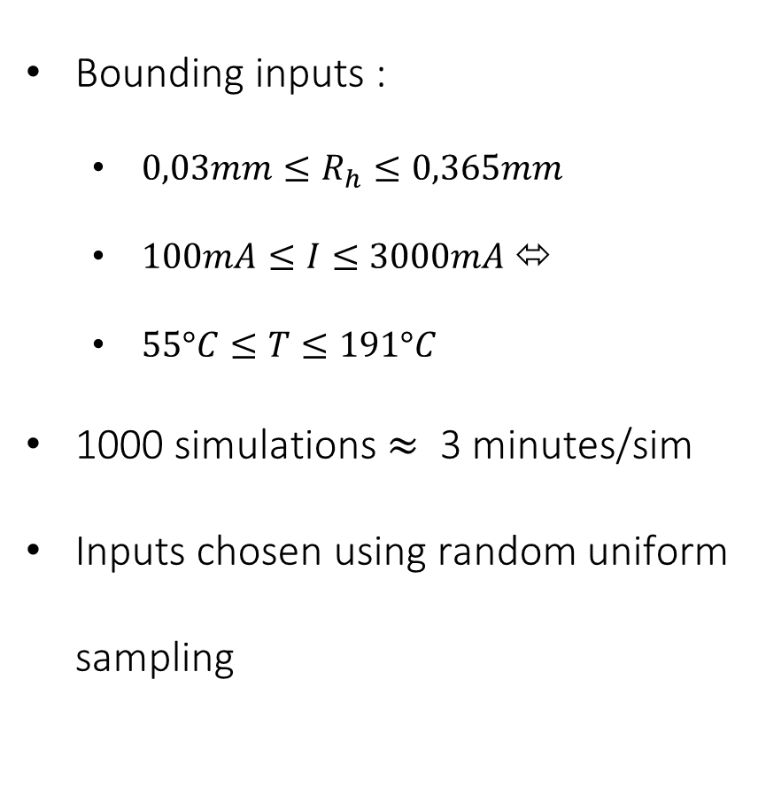
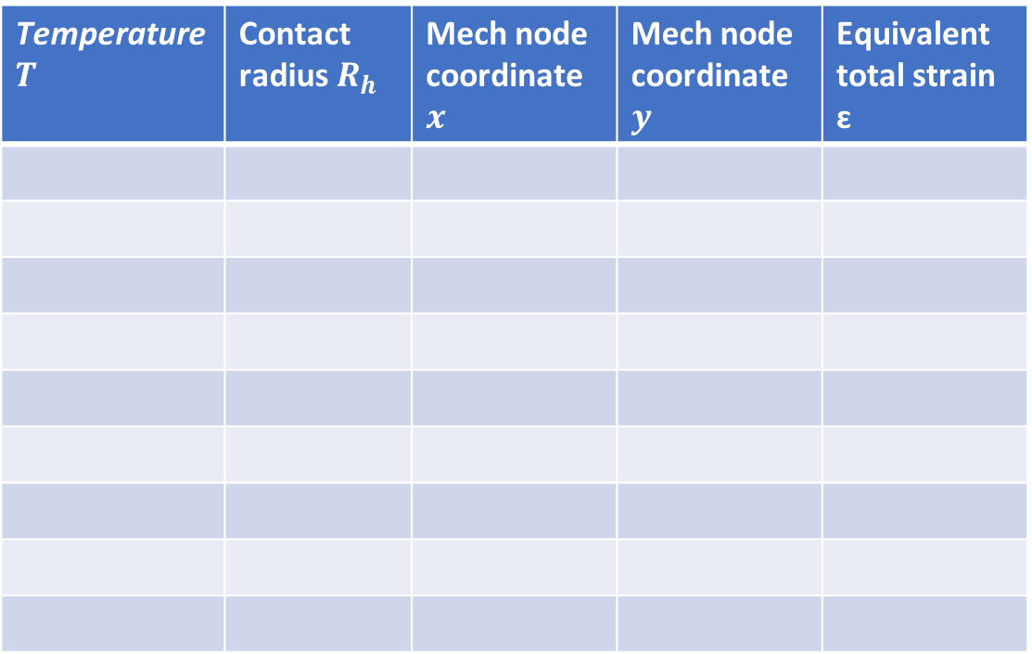
SIMULATIONS AND DATA GENERATION
Data generation
Input
Output
Bounding inputs :
$0,03mm≤R_{h}≤0,365mm$
$100mA≤I≤3000mA$ ⬄
$55°C≤T≤191°C$
1000 simulations $≈$ 3 minutes/sim
Inputs chosen using random uniform sampling
Temperature $T$ | Contact radius$R_{h}$ | Mech node coordinate $x$ | Mech node coordinate $y$ | Equivalent total strain ɛ

Slide 17
OUTLINE
Introduction
Simulations and data generation
Regression results and analysis
Machine learning beyond regression
Conclusion

Slide 18
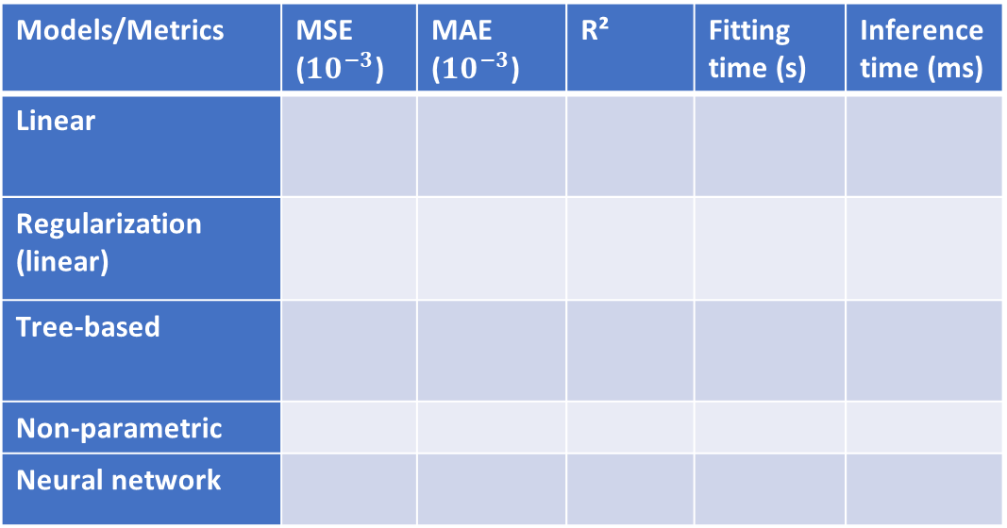
REGRESSION RESULTS AND ANALYSIS
Results
Parameters estimated using cross-validation
70-30 training-test splits
Models/Metrics | MSE ($10^{−3}$) | MAE ($10^{−3}$) | R² | Fitting time (s) | Inference time (ms)
Linear
Regularization (linear)
Tree-based
Non-parametric
Neural network

Slide 19
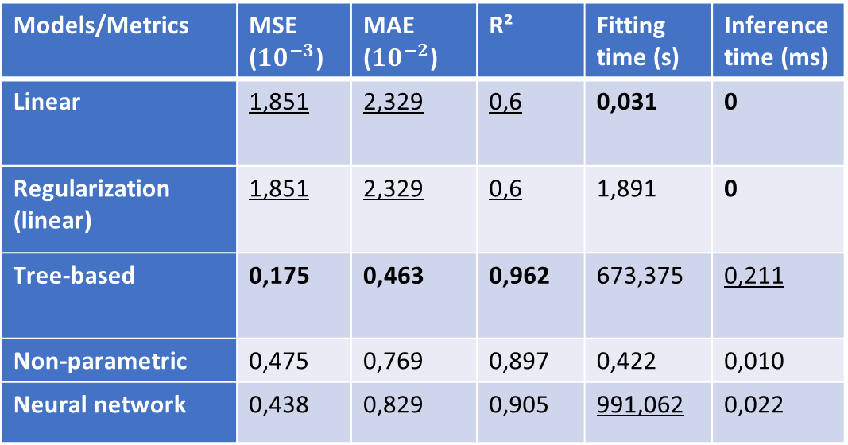
REGRESSION RESULTS AND ANALYSIS
Results
Tree-based models perform the best across all prediction metrics
Models/Metrics | MSE ($10^{−3}$) | MAE ($10^{−2}$) | R² | Fitting time (s) | Inference time (ms)
Linear | 1,851 | 2,329 | 0,6 | 0,031 | 0
Regularization (linear) | 1,851 | 2,329 | 0,6 | 1,891 | 0
Tree-based | 0,175 | 0,463 | 0,962 | 673,375 | 0,211
Non-parametric | 0,475 | 0,769 | 0,897 | 0,422 | 0,010
Neural network | 0,438 | 0,829 | 0,905 | 991,062 | 0,022
Regression results (best metric per column in bold, worst underlined)

Slide 20
REGRESSION RESULTS AND ANALYSIS
Results
Tree-based models perform the best across all prediction metrics
Regularization has a slight detrimental effect (Linear/Random forest/dropout) due to the deterministic nature
Models/Metrics | MSE ($10^{−3}$) | MAE ($10^{−2}$) | R² | Fitting time (s) | Inference time (ms)
Linear | 1,851 | 2,329 | 0,6 | 0,031 | 0
Regularization (linear) | 1,851 | 2,329 | 0,6 | 1,891 | 0
Tree-based | 0,175 | 0,463 | 0,962 | 673,375 | 0,211
Non-parametric | 0,475 | 0,769 | 0,897 | 0,422 | 0,010
Neural network | 0,438 | 0,829 | 0,905 | 991,062 | 0,022
Regression results (best metric per column in bold, worst underlined)

Slide 21
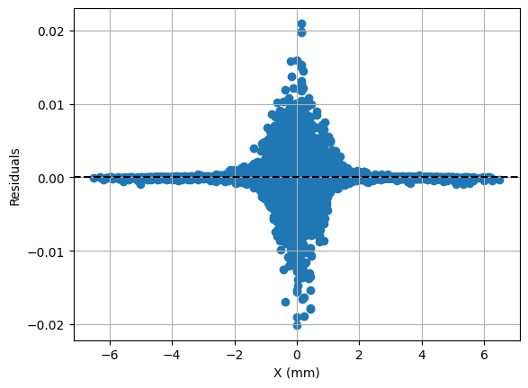
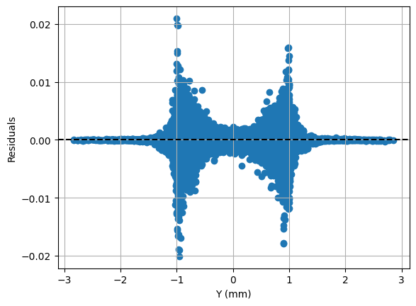
REGRESSION RESULTS AND ANALYSIS
Residuals
Residuals of the best performing model (Bagging) with respect to geometric features

Slide 22
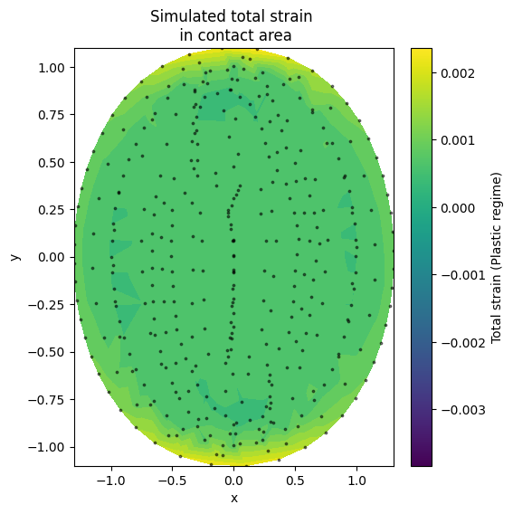
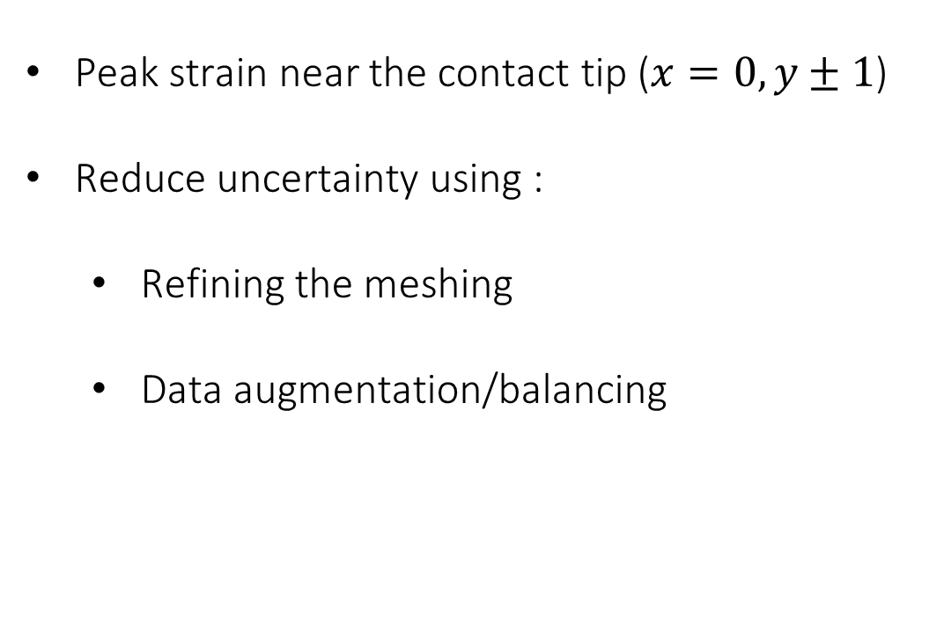
REGRESSION RESULTS AND ANALYSIS
Residuals
Peak strain near the contact tip ($x=0, y±1$)
Reduce uncertainty using :
Refining the meshing
Data augmentation/balancing
Visualization of a simulation showing the equivalent total strain in the elliptic contact area

Slide 23
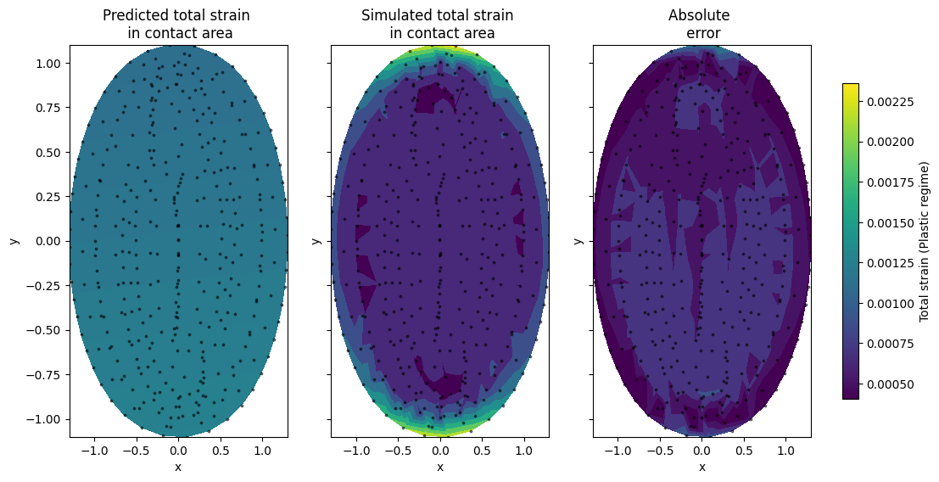
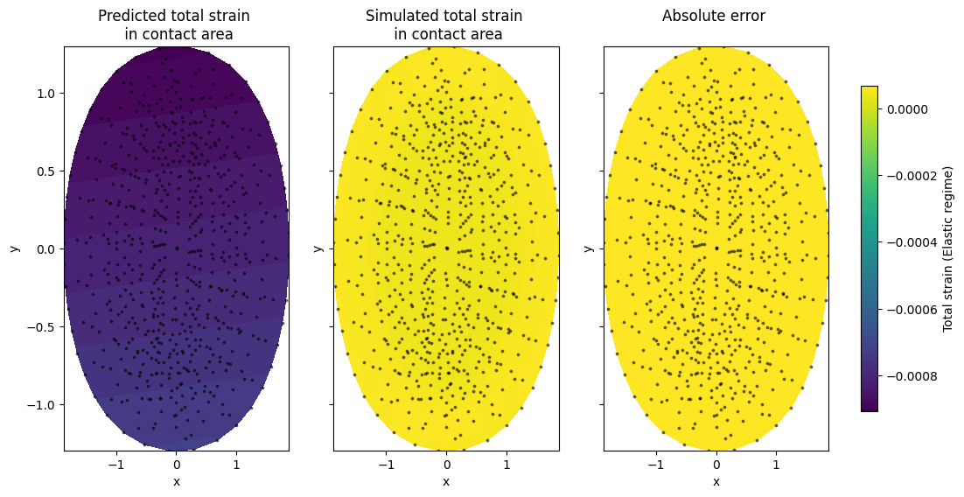
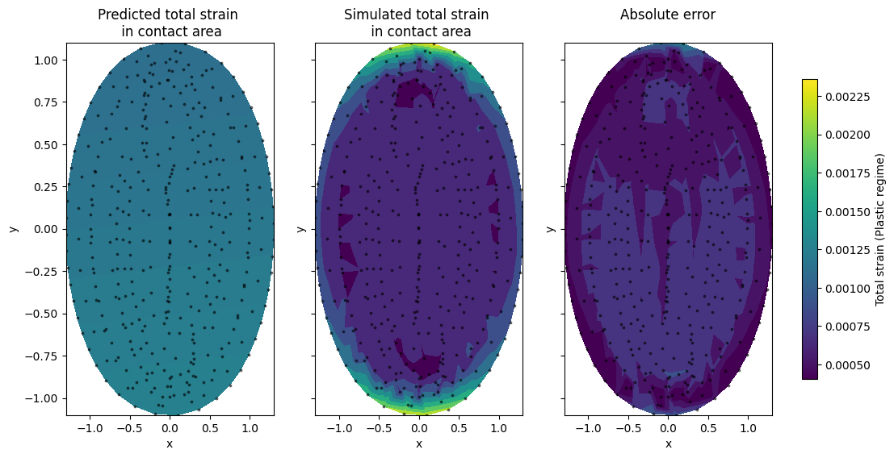

REGRESSION RESULTS AND ANALYSIS
Visualization : Linear regression

Slide 24

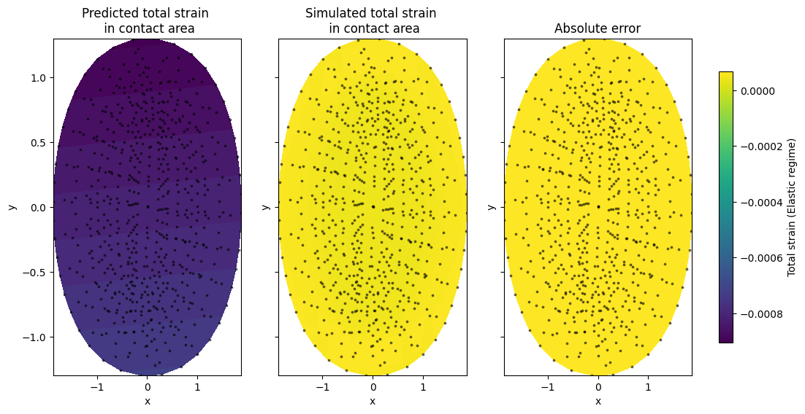

REGRESSION RESULTS AND ANALYSIS
Visualization : LASSO

Slide 25


REGRESSION RESULTS AND ANALYSIS
Visualization : Ridge

Slide 26


REGRESSION RESULTS AND ANALYSIS
Visualization : ElasticNet

Slide 27
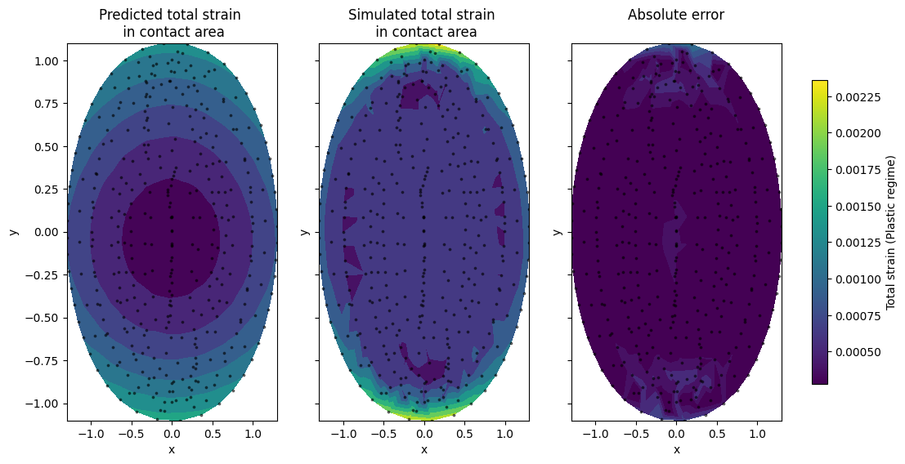
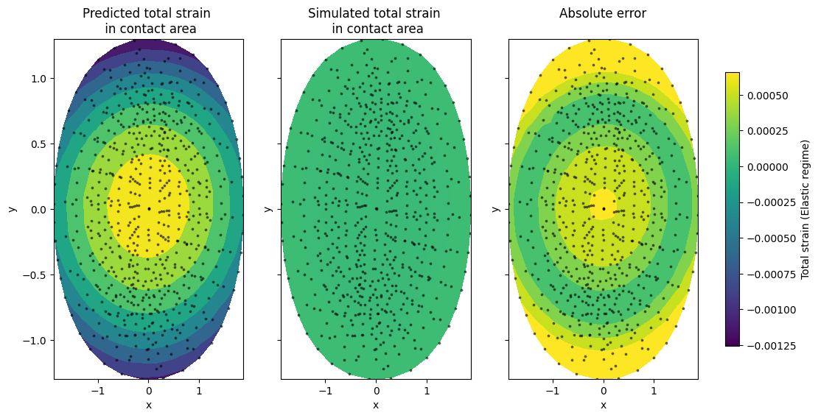
REGRESSION RESULTS AND ANALYSIS
Visualization : Polynomial (degree 4)

Slide 28
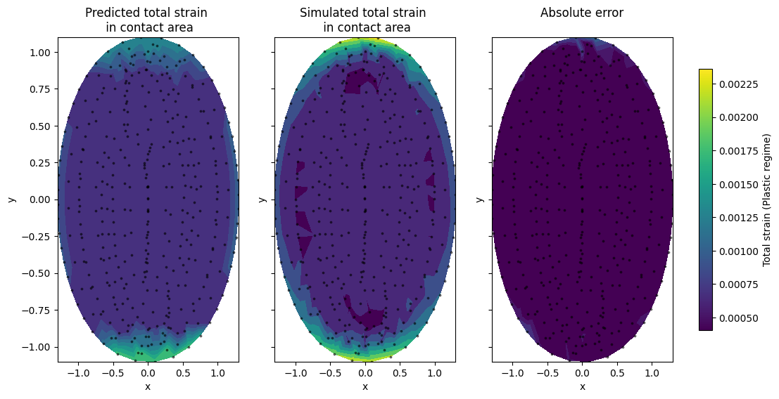
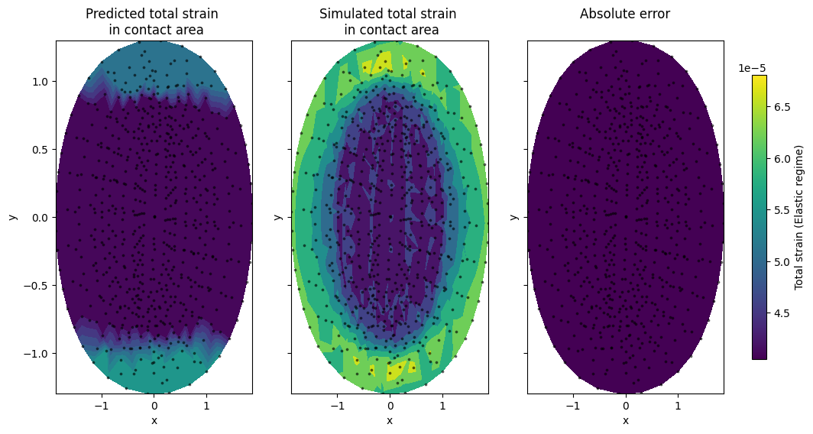
REGRESSION RESULTS AND ANALYSIS
Visualization : Decision Tree

Slide 29
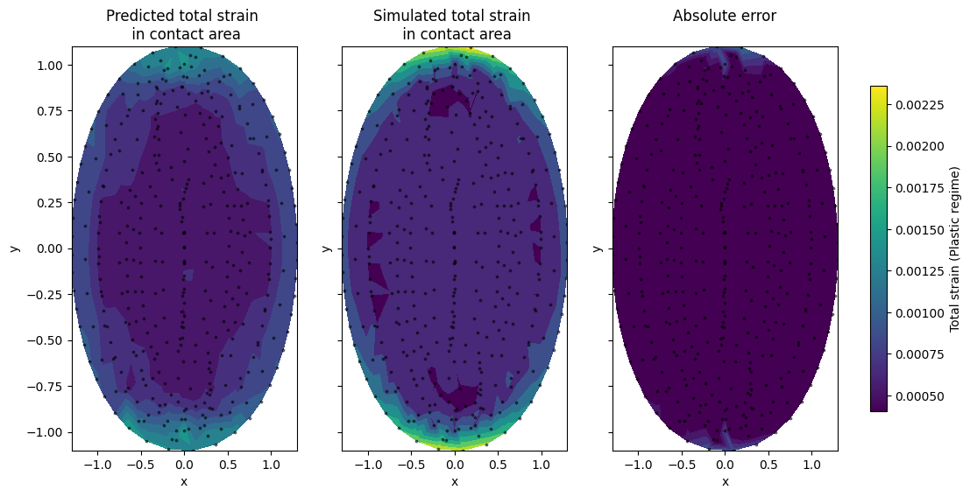
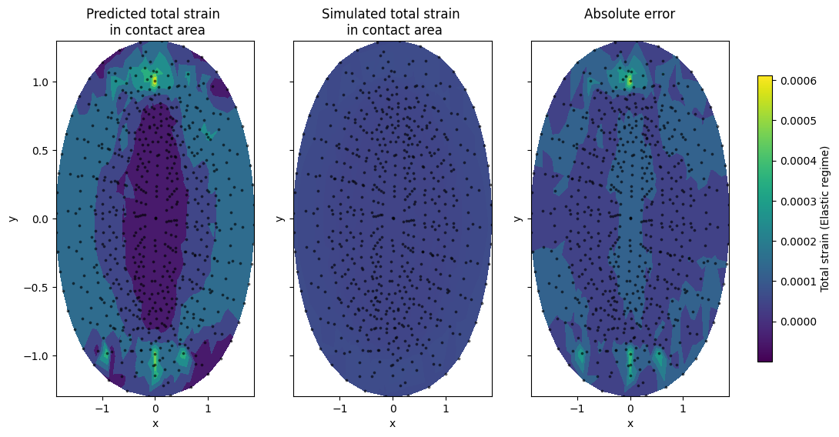
REGRESSION RESULTS AND ANALYSIS
Visualization : Boosting

Slide 30
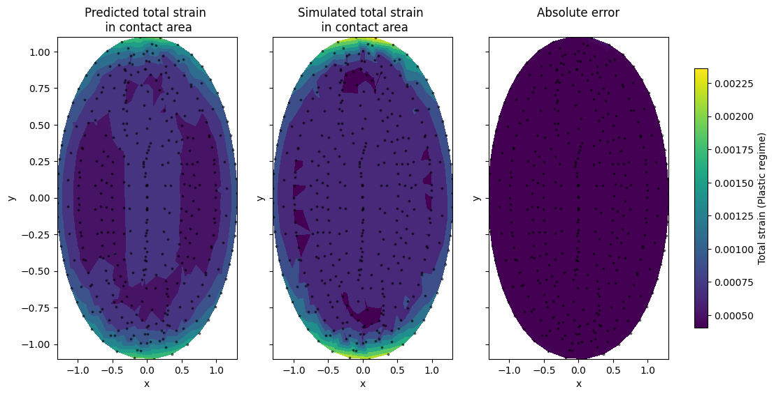
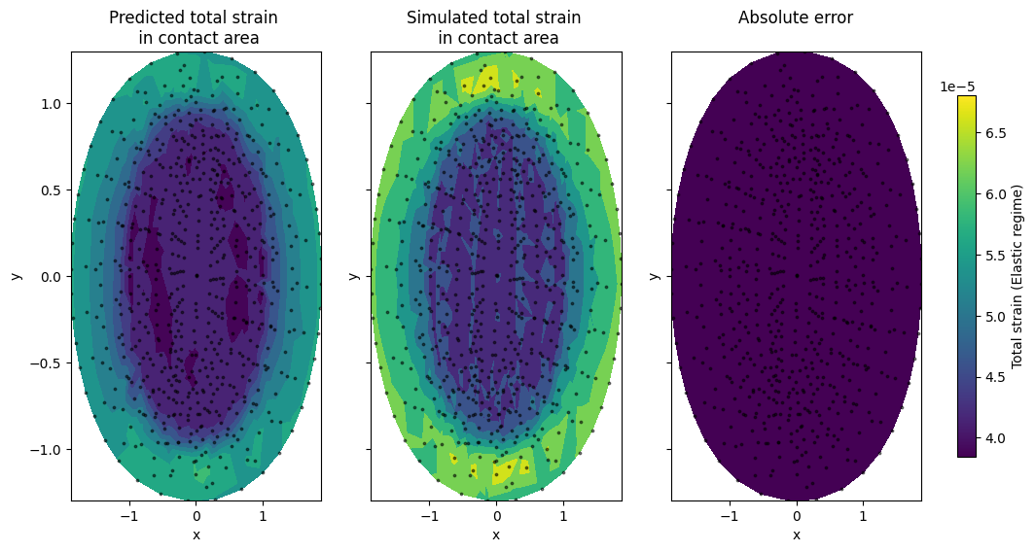
REGRESSION RESULTS AND ANALYSIS
Visualization : Random forest

Slide 31


REGRESSION RESULTS AND ANALYSIS
Visualization : Bagging

Slide 32
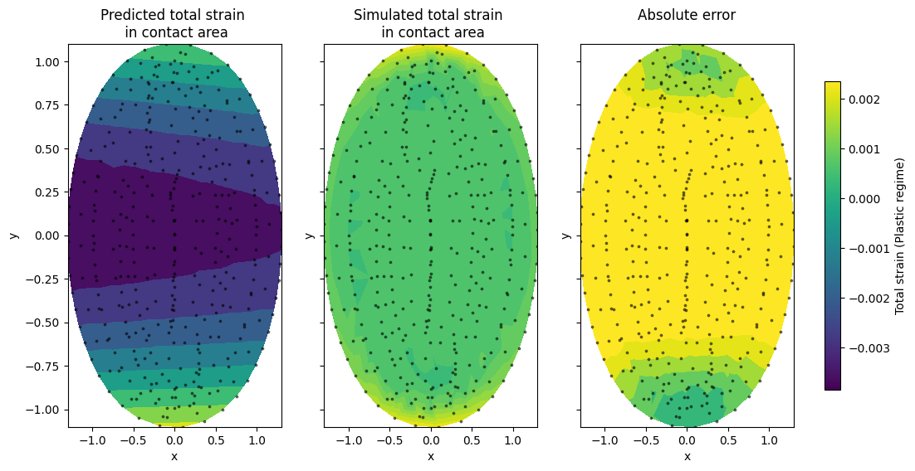
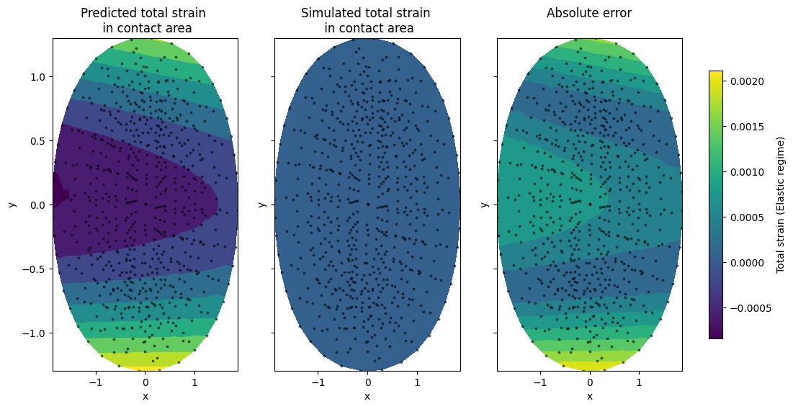
REGRESSION RESULTS AND ANALYSIS
Visualization : Support vector regression

Slide 33
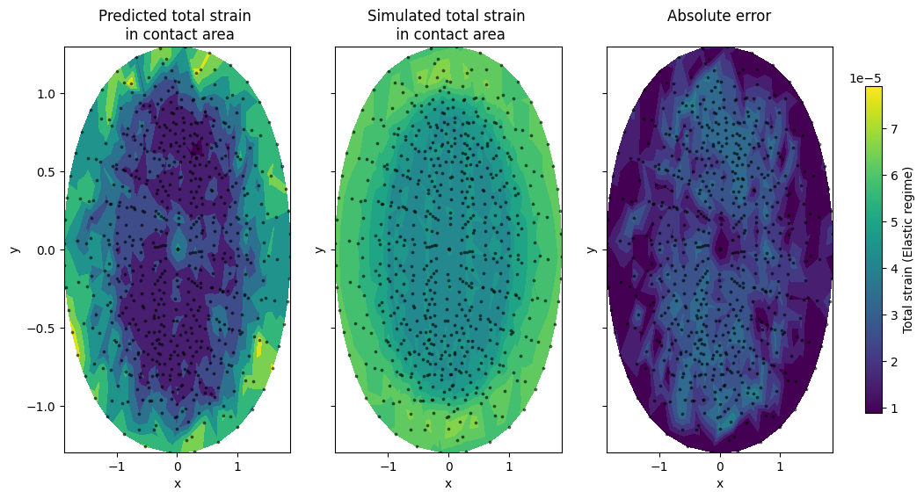

REGRESSION RESULTS AND ANALYSIS
Visualization : k-Nearest neighbours regressor

Slide 34
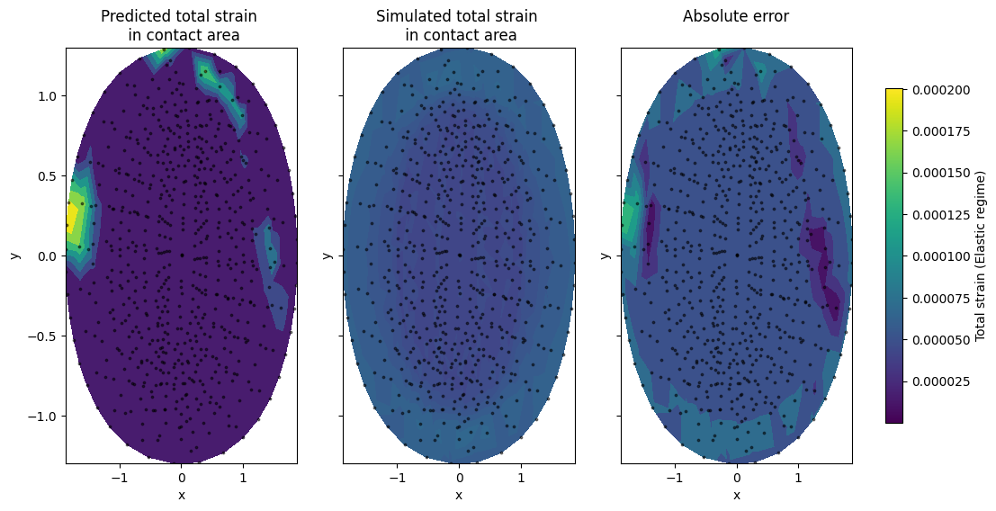
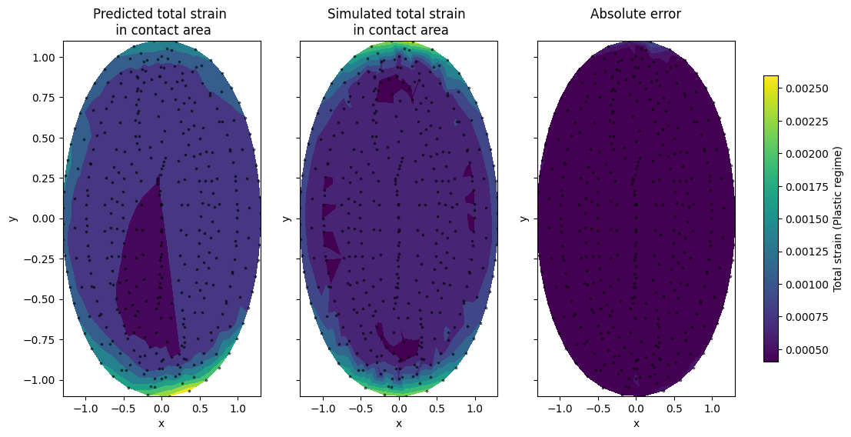
REGRESSION RESULTS AND ANALYSIS
Visualization : Neural networks

Slide 35
OUTLINE
Introduction
Simulations and data generation
Regression results and analysis
Machine learning beyond regression
Conclusion

Slide 36
MACHINE LEARNING BEYOND REGRESSION
Active learning
A machine learning approach that attempts to maximize a model’s performance gain while annotating the fewest samples possible
Uses model uncertainty to determine the most important sample to annotate

Slide 37



MACHINE LEARNING BEYOND REGRESSION
Active learning : example

Slide 38
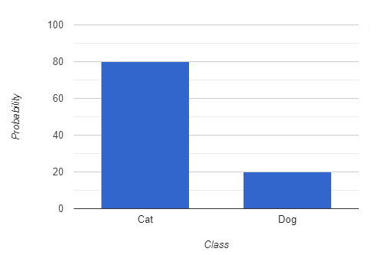
MACHINE LEARNING BEYOND REGRESSION
Active learning : example

Slide 39
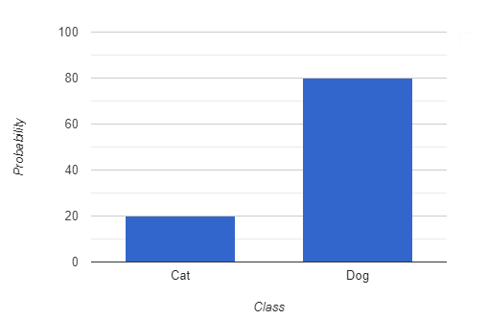
MACHINE LEARNING BEYOND REGRESSION
Active learning : example

Slide 40
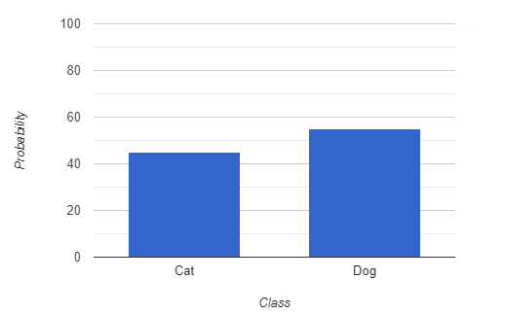
MACHINE LEARNING BEYOND REGRESSION
Active learning : example

Slide 41
MACHINE LEARNING BEYOND REGRESSION
Active learning : example
Highest uncertainty = most important to label

Slide 42
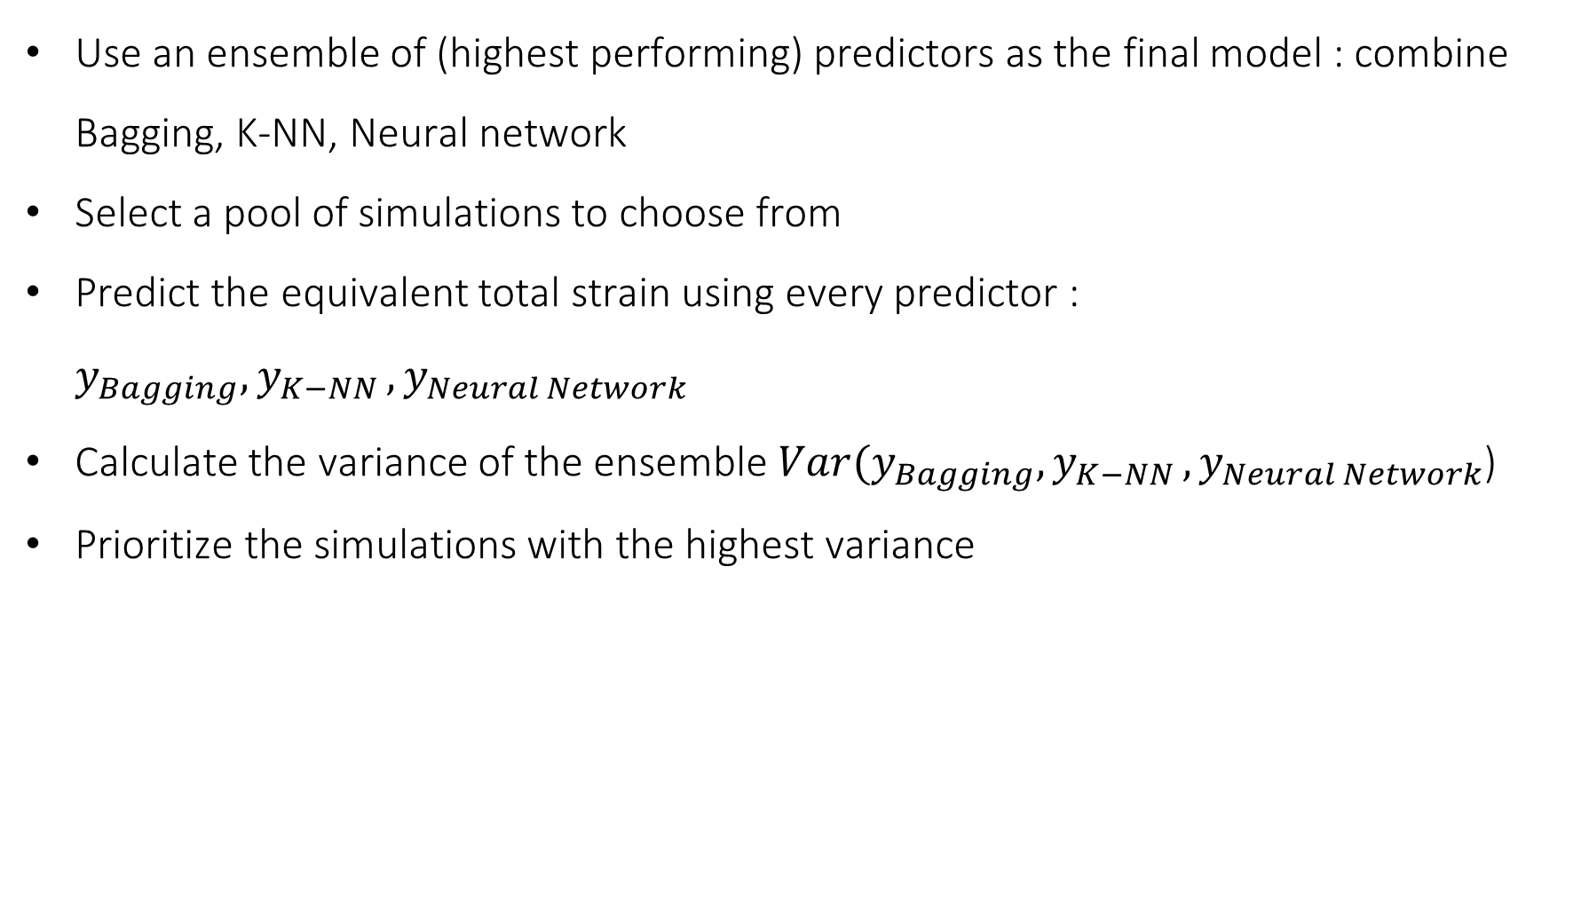
MACHINE LEARNING BEYOND REGRESSION
Active learning : adaptation
Use an ensemble of (highest performing) predictors as the final model : combine Bagging, K-NN, Neural network
Select a pool of simulations to choose from
Predict the equivalent total strain using every predictor : $y_{Bagging}, y_{K−NN }, y_{Neural Network}$
Calculate the variance of the ensemble $Var(y_{Bagging}, y_{K−NN }, y_{Neural Network}$)
Prioritize the simulations with the highest variance

Slide 43
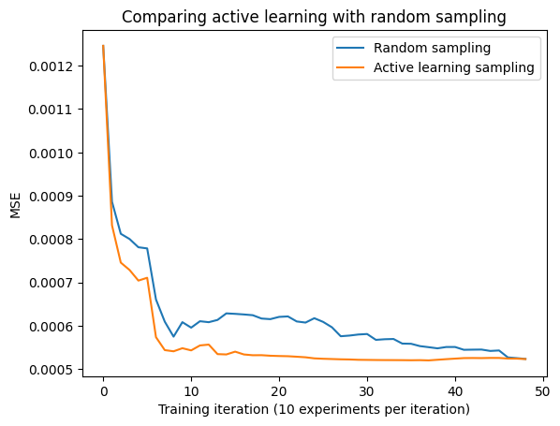
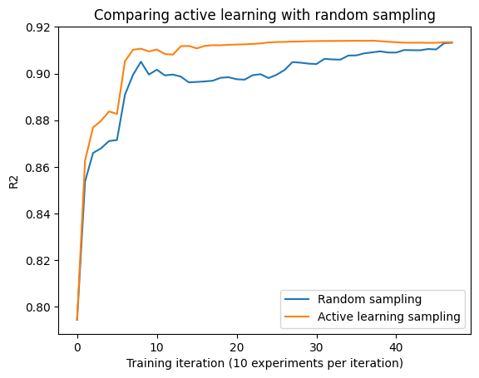
MACHINE LEARNING BEYOND REGRESSION
Active learning : results
Active learning using 50 test simulations, 50 initial training simulations and 500 pool simulations (fully utilized)

Slide 44
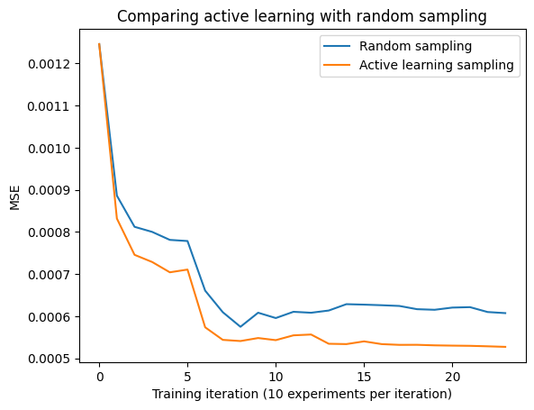
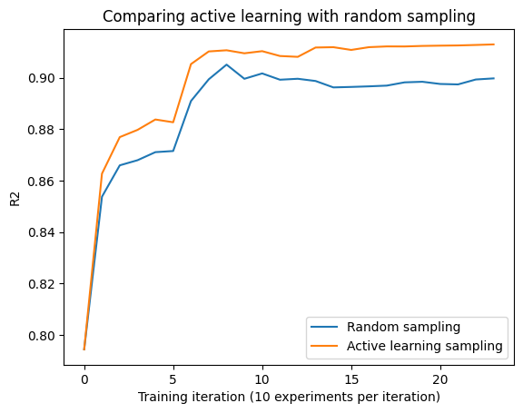
MACHINE LEARNING BEYOND REGRESSION
Active learning : results
Active learning using 50 test simulations, 50 initial training simulations and 500 pool simulations (50% utilized)

Slide 45
OUTLINE
Introduction
Simulations and data generation
Regression results and analysis
Machine learning beyond regression
Conclusion

Slide 46
CONCLUSION
Takeaways
Machine learning models give plausible results when used as surrogate models for finite element models in power module’s reliability assessment
Tree-based models have the best statistical properties due to their decision-based regression, with K-NNs being competitive statistically and computationally
Residuals can guide the user in the data selection and generation process
Active learning improves convergence time and increases accuracy by choosing iteratively the best numerical simulations to carry out

Slide 47
CONCLUSION
Improvements and future work
Transfer learning is an interesting approach to tackle the problem of complex and scarce simulations
The effect of meshing can be the topic of future work to optimize computational time and improve accuracy
Uncertainty should be quantified, and machine learning should be used with caution for applications with a high risk and a limited margin of tolerance

Slide 48


Thank you for your attention!
Contact :
mehdi.ghrabli1@ens-paris-saclay.fr
Project repository :
github.com/MehdiGhrabli/ML4FE
Related :
github.com/MehdiGhrabli/PIMC4RUL

Slide 49
REFERENCES
[1] T. Hunger et al. Surge current limitations. Power systems design, 2011. https://www.powersystemsdesign.com/articles/surge-current-limitations/22/5852
[2] Thoben, M. & Mainka, Krzysztof & Bayerer, Reinhold & Graf, I & Münzer, M. (2008). From vehicle drive cycle to reliability testing of Power Modules for hybrid vehicle inverter.
[3] N. Dornic. Elaboration et comparaison de deux modèles de durée de vie des fils d’interconnexion des modules de puissance, l’un base sur les déformations et l’autre sur les dégradations. PhD thesis, Université Paris-Saclay, 2019.
[4] Camille Durand, Markus Klingler, Coutellier Daniel, and Hakim Naceur. Powercycling reliability of power module: A survey. IEEE Transactions on Deviceand Materials Reliability, 16:1–1, 03 2016.
[5] Hichem Felouat, Transfer learning Keras & TensorFlow. 2020.

Slide 50
MACHINE LEARNING BEYOND REGRESSION
Transfer learning
A machine learning technique that involves utilizing knowledge learned from one task to improve performance on another related task.
Beneficial when the second task is related to the first and/or when data for the second task is scarce

Slide 51

MACHINE LEARNING BEYOND REGRESSION
Transfer learning : example
Task 1 : Image recognition of cats
Accessible data, easy to train models
Taks 2 : Image recognition of tigers
Limited data, hard to train models
Solution : Use transfer learning to share knowledge (Feature detection of whiskers, eyes, ears) from task 1 to task 2

Slide 52
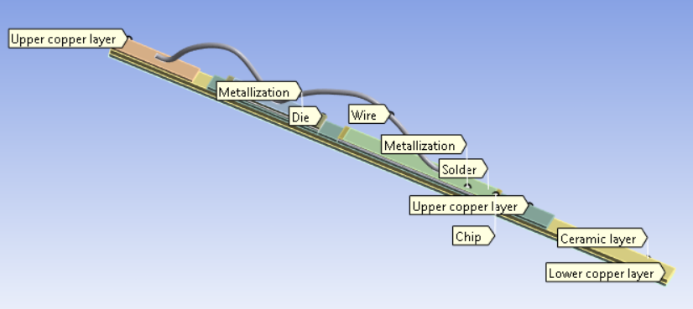
MACHINE LEARNING BEYOND REGRESSION
Transfer learning : Application
Task 1 : Surrogate model used on simplified geometry
Accessible data, easy to train models
Taks 2 : Surrogate model used on complex geometry
Limited data, hard to train models
Solution : Use transfer learning to share knowledge (Geometric features, relationship between node values) from task 1 to task 2

Slide 53
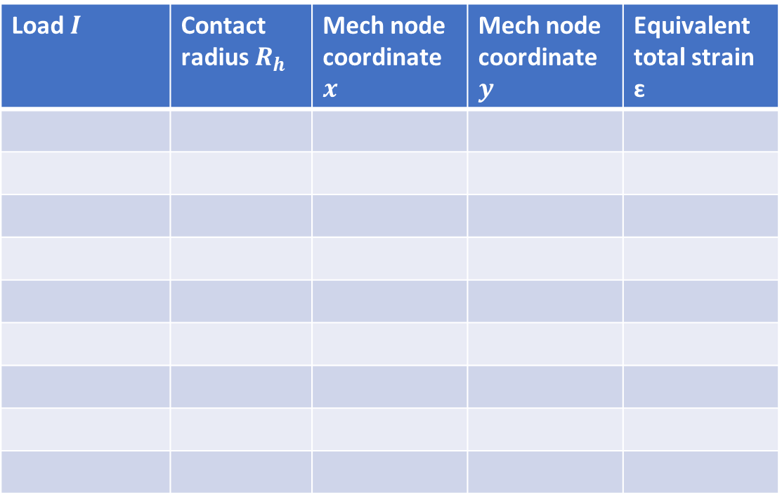
SIMULATIONS AND DATA GENERATION
Data generation
Input
Output
Load $I$ | Contact radius$R_{h}$ | Mech node coordinate $x$ | Mech node coordinate $y$ | Equivalent total strain ɛ

Slide 54
SIMULATIONS AND DATA GENERATION
Data generation
Input
Output
Temperature $T$ | Contact radius$R_{h}$ | Mech node coordinate $x$ | Mech node coordinate $y$ | Equivalent total strain ɛ

Slide 55
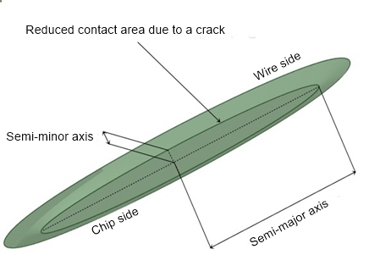
SIMULATIONS AND DATA GENERATION
Geometric modelling
Reduced geometric model of the power module
Truncated cone representing the elliptical contact area

Slide 56
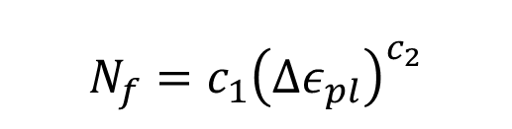
INTRODUCTION
Remaining useful life estimation
Pointwise estimation
Simple model
Quick inference (estimation at the initial state)
Restricting assumptions
$$N_{f}=c_{1}{\left(Δε_{pl}\right)}^{c_{2}}$$
Coffin-Manson law

Slide 57
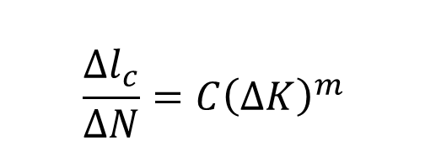
INTRODUCTION
Remaining useful life estimation
Pointwise estimation
Sequence-based estimation
Simple model
Quick inference (estimation at the initial state)
Restricting assumptions
Complex model
Slow inference (estimation after every loading cycle)
Robust to load variation
$$\frac{Δl_{c}}{ΔN}=C{\left(ΔK\right)}^{m}$$
$$N_{f}=c_{1}{\left(Δε_{pl}\right)}^{c_{2}}$$
Coffin-Manson law
Paris’ law

Slide 58
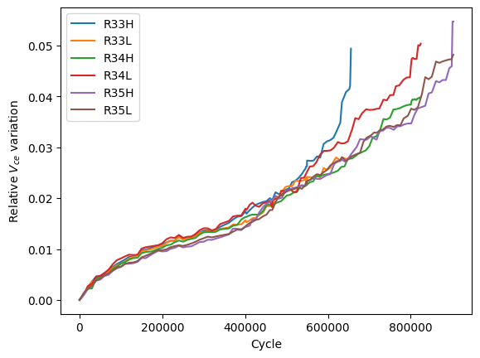
INTRODUCTION
Remaining useful life estimation
Pointwise estimation
Sequence-based estimation
Simple model
Quick inference (estimation at the initial state)
Restricting assumptions
Uses feedback loops (health indicator + finite element model)
$$N_{f}=c_{1}{\left(Δε_{pl}\right)}^{c_{2}}$$
Coffin-Manson law
Evolution of the health indicator with respect to the number of loading cycles

Slide 59
INTRODUCTION
Remaining useful life estimation
Pointwise estimation
Sequence-based estimation
Simple model
Quick inference (estimation at the initial state)
Restricting assumptions
Uses feedback loops (health indicator + surrogate machine learning model)
$$N_{f}=c_{1}{\left(Δε_{pl}\right)}^{c_{2}}$$
Coffin-Manson law
Evolution of the health indicator with respect to the number of loading cycles

Slide 60

REGRESSION RESULTS AND ANALYSIS
Interpretation : Linear model
Parameters estimated using cross-validation
70-30 training-test splits
 | MSE ($10^{−3}$) | MAE ($10^{−3}$) | R² | Fitting time (s) | Inference time (ms)
Linear | 1,851 | 2,329 | 0,6 | 0,031 | 0
Polynomial model (degree 4) | 0,66 | 1,161 | 0,857 | 2,032 | 8,780$×{10}^{−4}$
Regression results (best metric per row in bold, worst underlined)

Slide 61

REGRESSION RESULTS AND ANALYSIS
Interpretation : Regularization
Parameters estimated using cross-validation
70-30 training-test splits
 | MSE ($10^{−3}$) | MAE ($10^{−2}$) | R² | Fitting time (s) | Inference time (ms)
Linear | 1,851 | 2,329 | 0,6 | 0,031 | 0
Ridge | 1,851 | 2,329 | 0,6 | 1,891 | 0
Lasso | 1,851 | 2,329 | 0,6 | 3,406 | 1,124$×10^{−4}$
Bagging | 0,175 | 0,463 | 0,962 | 673,375 | 0,211
Random forest | 0,184 | 0,477 | 0,960 | 536,203 | 0,205
Regression results (best metric per row in bold, worst underlined)

Slide 62

REGRESSION RESULTS AND ANALYSIS
Interpretation : Non-parametric models
Parameters estimated using cross-validation
70-30 training-test splits
 | MSE ($10^{−3}$) | MAE ($10^{−3}$) | R² | Fitting time (s) | Inference time (ms)
K-NN | 0,475 | 0,769 | 0,897 | 0,422 | 0,010
Support vector regression | 2,243 | 3,813 | 0,515 | 47,047 | 0,236
Regression results (best metric per row in bold, worst underlined)

Slide 63

REGRESSION RESULTS AND ANALYSIS
Interpretation : Tree-based models
Parameters estimated using cross-validation
70-30 training-test splits
 | MSE ($10^{−3}$) | MAE ($10^{−2}$) | R² | Fitting time (s) | Inference time (ms)
Decision tree | 0,521 | 0,921 | 0,887 | 0,922 | 1,053$×{10}^{−4}$
Random forest | 0,184 | 0,477 | 0,960 | 536,203 | 0,205
Bagging | 0,175 | 0,463 | 0,962 | 673,375 | 0,211
Boosting | 0,408 | 0,799 | 0,912 | 61 | 1,643$×{10}^{−3}$
Regression results (best metric per row in bold, worst underlined)

Slide 64



REGRESSION RESULTS AND ANALYSIS
Interpretation : Neural networks
 | MSE ($10^{−3}$) | MAE ($10^{−2}$) | R² | Fitting time (s) | Inference time (ms)
Neural networks | 0,438 | 0,829 | 0,905 | 991,062 | 0,022
Regression results (Neural network)

Slide 65




REGRESSION RESULTS AND ANALYSIS
Hyperparameter estimation

Slide 66




REGRESSION RESULTS AND ANALYSIS
Residual plots

Slide 67

SIMULATIONS AND DATA GENERATION
Crack length vs health indicator
Gaussian process regression is used to estimate the crack length from the health indicator

Slide 68

USE CASE
Predictions using a surrogate ML model
Remaining useful life estimation using a Markov chain model coupled with support vector regression as a surrogate model

Slide 69
SIMULATIONS AND DATA GENERATION
Plasticity
Metallization layer and wire (Al) : Bilinear Kinematic Hardening :
Yield stress σ = 29MPa
Tangent modulus E = 35.5MPa
Copper : Chaboche Kinematic Hardening : 2 modes :
T = 20◦C : C1 = 54.041MPa, γ1 = 962, C2 = 721MPa, γ2 = 1.1
T = 50◦C : C1 = 52.880MPa, γ1 = 1000, C2 = 700MPa, γ2 = 1.1
T = 150◦C : C1 = 45.760MPa, γ1 = 1100, C2 = 600MPa, γ2 = 1.1

Slide 70
SIMULATIONS AND DATA GENERATION
Plasticity
Metallization layer and wire (Al) : Bilinear Kinematic Hardening :
Yield stress σ = 29MPa
Tangent modulus E = 35.5MPa
Copper : Chaboche Kinematic Hardening : 2 modes :
T = 20◦C : C1 = 54.041MPa, γ1 = 962, C2 = 721MPa, γ2 = 1.1
T = 50◦C : C1 = 52.880MPa, γ1 = 1000, C2 = 700MPa, γ2 = 1.1
T = 150◦C : C1 = 45.760MPa, γ1 = 1100, C2 = 600MPa, γ2 = 1.1

Slide 71


REGRESSION RESULTS AND ANALYSIS
Effect of quadratic features
Regular features | MSE ($10^{−3}$) | MAE ($10^{−2}$) | R² | Fitting time (s) | Inference time (ms)
Linear | 1,851 | 2,329 | 0,6 | 0,031 | 0
Regularization (linear) | 1,851 | 2,329 | 0,6 | 1,891 | 0
Tree-based | 0,175 | 0,463 | 0,962 | 673,375 | 0,211
Non-parametric | 0,475 | 0,769 | 0,897 | 0,422 | 0,010
Neural network | 0,438 | 0,829 | 0,905 | 991,062 | 0,022
Augmented features | MSE ($10^{−3}$) | MAE ($10^{−2}$) | R² | Fitting time (s) | Inference time (ms)
Linear | 1,647 | 2,326 | 0,637 | 0,047 | 0
Regularization (linear) | 1,647 | 2,326 | 0,637 | 2,187 | 0
Tree-based | 0,110 | 0,369 | 0,976 | 1072,156 | 0,242
Non-parametric | 0,429 | 0,737 | 0,906 | 0,688 | 0,019
Neural network | 0,275 | 0,672 | 0,939 | 953,175 | 0,018

Slide 72
SIMULATIONS AND DATA GENERATION
Plasticity
Metallization layer and wire (Al) : Bilinear Kinematic Hardening :
H. Lu and C. Bailey (2014) Application of nonlinear fatigue damage models in power electronic module wire bond structure under various amplitude loadings, Advances in Manufacturing
Copper : Chaboche Kinematic Hardening : 2 modes :
Y. Liu and S. Liu (2014) Modeling and simulation of power electronic modules with microchannel coolers for thermo-mechanical performance, Microelectronics Reliability

Slide 73
MACHINE LEARNING BEYOND REGRESSION
Transfer learning : challenge
Utilize architectures that present a clear hierarchical structure such as radial basis function networks and autoencoders

Slide 74





REGRESSION RESULTS AND ANALYSIS
Consistent models : MSE

